Slide 1
Elective Module 3 – Node JS
(17 hours)
Notes:
Title - The learning outcome
Subtitle - Duration

Slide 2
In this section, we will discuss:
Create Module & export, import
Introduction package.json file
File Handling
Create Event Driven Programming
Socket Programming
Create Own web server
Notes:
Mention the parent topics one by one. This particular learning outcome has 4 parent topics.

Slide 3
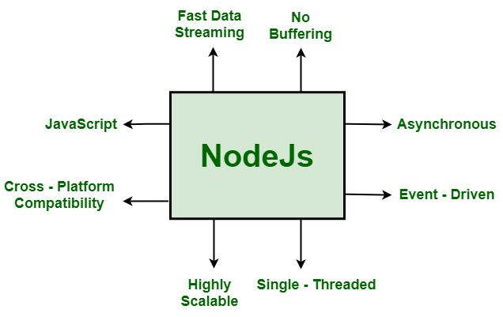
Node JS
What is the Node JS
Node.js is an open source server environment
Node.js is free
Node.js runs on various platforms (Windows, Linux, Unix, Mac OS X, etc.)
Node.js uses JavaScript on the server
Image Source: https://media.geeksforgeeks.org/wp-content/uploads/20211025202251/UntitledDiagramdrawio2.png
Notes:
Left (White Color space):
Title - Parent Topic
Subtitle - Subtopic 1
Body Text - Description in bullets
Right (Grey Color Space):
Body Text - Relevant image (with source)/code snippet
Put reference links in Speaker Notes
Reference:
https://www.tutorialspoint.com/internet_technologies/internet_overview.htm/

Slide 4
Node JS
What Can Node.js Do?
Node.js can generate dynamic page content
Node.js can create, open, read, write, delete, and close files on the server
Node.js can collect form data
Node.js can add, delete, modify data in your database
Image Source: https://media.geeksforgeeks.org/wp-content/uploads/20211025202251/UntitledDiagramdrawio2.png
Notes:
Left (White Color space):
Title - Parent Topic
Subtitle - Subtopic 1
Body Text - Description in bullets
Right (Grey Color Space):
Body Text - Relevant image (with source)/code snippet
Put reference links in Speaker Notes
Reference:
https://www.tutorialspoint.com/internet_technologies/internet_overview.htm/

Slide 5
Node JS
What is a Node.js File?
Node.js files contain tasks that will be executed on certain events
A typical event is someone trying to access a port on the server
Node.js files must be initiated on the server before having any effect
Node.js files have extension ".js"
Image Source: https://media.geeksforgeeks.org/wp-content/uploads/20211025202251/UntitledDiagramdrawio2.png
Notes:
Left (White Color space):
Title - Parent Topic
Subtitle - Subtopic 1
Body Text - Description in bullets
Right (Grey Color Space):
Body Text - Relevant image (with source)/code snippet
Put reference links in Speaker Notes
Reference:
https://www.tutorialspoint.com/internet_technologies/internet_overview.htm/

Slide 6

Node JS
Import and Export in Node.js
Importing and exporting files are important parts of any programming language. Importing functions or modules enhances the reusability of code. When the application grows in size, maintaining a single file with all the functions and logic becomes difficult. It also hinders the process of debugging. Therefore, it is good practice to create separate files for specific functions and later import them as per requirement.
Image Source: https://miro.medium.com/max/1400/1*weLWZQ7KkJUdXrJeRlTrKg.jpeg
Notes:
Left (White Color space):
Title - Parent Topic
Subtitle - Subtopic 1
Body Text - Description in bullets
Right (Grey Color Space):
Body Text - Relevant image (with source)/code snippet
Put reference links in Speaker Notes
Reference:
https://www.tutorialspoint.com/internet_technologies/internet_overview.htm/

Slide 7
Node JS
Import and Export in Node.js
Node.js also allows importing and exporting functions and modules. Functions in one module can be imported and called in other modules saving the effort to copy function definitions into the other files. The module can be edited or debugged separately making it easier to add or remove features.
Image Source: https://miro.medium.com/max/1400/1*weLWZQ7KkJUdXrJeRlTrKg.jpeg
Notes:
Left (White Color space):
Title - Parent Topic
Subtitle - Subtopic 1
Body Text - Description in bullets
Right (Grey Color Space):
Body Text - Relevant image (with source)/code snippet
Put reference links in Speaker Notes
Reference:
https://www.tutorialspoint.com/internet_technologies/internet_overview.htm/

Slide 8
Node JS
Steps to include functions from other files
Creating a Module
Exporting a Module: Filename: func.js
Importing a Module:
Image Source: https://miro.medium.com/max/1400/1*weLWZQ7KkJUdXrJeRlTrKg.jpeg
Notes:
Left (White Color space):
Title - Parent Topic
Subtitle - Subtopic 1
Body Text - Description in bullets
Right (Grey Color Space):
Body Text - Relevant image (with source)/code snippet
Put reference links in Speaker Notes
Reference:
https://www.tutorialspoint.com/internet_technologies/internet_overview.htm/

Slide 9
Node JS
Creating a Module
Modules are created in Node.js are JavaScript files. Every time a new file with .js extension is created, it becomes a module.
Image Source: https://miro.medium.com/max/1400/1*weLWZQ7KkJUdXrJeRlTrKg.jpeg
Notes:
Left (White Color space):
Title - Parent Topic
Subtitle - Subtopic 1
Body Text - Description in bullets
Right (Grey Color Space):
Body Text - Relevant image (with source)/code snippet
Put reference links in Speaker Notes
Reference:
https://www.tutorialspoint.com/internet_technologies/internet_overview.htm/

Slide 10
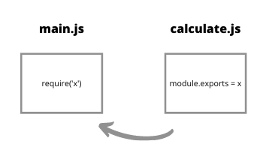
Node JS
Exporting a Module: Filename: func.js
function add(x, y) {
return x + y;
}
function subtract(x, y) {
return x - y;
}
// Adding the code below to allow importing
// the functions in other files
module.exports = { add }
Image Source: https://cdn.hashnode.com/res/hashnode/image/upload/v1603082860893/xGgR903x4.png
Notes:
Left (White Color space):
Title - Parent Topic
Subtitle - Subtopic 1
Body Text - Description in bullets
Right (Grey Color Space):
Body Text - Relevant image (with source)/code snippet
Put reference links in Speaker Notes
Reference:
https://www.tutorialspoint.com/internet_technologies/internet_overview.htm/

Slide 11
Node JS
Filename: main.js
// Importing the func.js module
// The ./ says that the func module
// is in the same directory as
// the main.js file
const f = require('./func');
// Require returns an object with add()
// and stores it in the f variable
// which is used to invoke the required
const result = f.add(10, 5);
console.log('The result is:', result);
Output:
The result is: 15
Importing a Module
We need to import the module to use the functions defined in the imported module in another file. The result returned by require() is stored in a variable which is used to invoke the functions using the dot notation.
Notes:
Left (White Color space):
Title - Parent Topic
Subtitle - Subtopic 1
Body Text - Description in bullets
Right (Grey Color Space):
Body Text - Relevant image (with source)/code snippet
Put reference links in Speaker Notes
Reference:
https://www.tutorialspoint.com/internet_technologies/internet_overview.htm/

Slide 12
Node JS
Filename: main.js
const f = require('./func');
console.log(f.add(4, 4));
console.log(f.subtract(8, 4));
Output:
8
4
Importing multiple functions from local file: Filename: func.js
function add(x, y) {
return x + y;
}
function subtract(x, y) {
return x - y;
}
module.exports = { add, subtract};
Notes:
Left (White Color space):
Title - Parent Topic
Subtitle - Subtopic 1
Body Text - Description in bullets
Right (Grey Color Space):
Body Text - Relevant image (with source)/code snippet
Put reference links in Speaker Notes
Reference:
https://www.tutorialspoint.com/internet_technologies/internet_overview.htm/

Slide 13
Node JS
Other ways to export a module
module.exports = {
add: function (x, y) {
return x + y;
},
subtract: function (x, y) {
return x - y;
},
};
Defining the functions inside module.exports object.
Notes:
Left (White Color space):
Title - Parent Topic
Subtitle - Subtopic 1
Body Text - Description in bullets
Right (Grey Color Space):
Body Text - Relevant image (with source)/code snippet
Put reference links in Speaker Notes
Reference:
https://www.tutorialspoint.com/internet_technologies/internet_overview.htm/

Slide 14
Node JS
Other ways to export a module
module.exports.add = function (x, y) {
return x + y;
};
module.exports.subtract = function (x, y) {
return x - y;
};
Defining each function independently as a method of module.exports
Notes:
Left (White Color space):
Title - Parent Topic
Subtitle - Subtopic 1
Body Text - Description in bullets
Right (Grey Color Space):
Body Text - Relevant image (with source)/code snippet
Put reference links in Speaker Notes
Reference:
https://www.tutorialspoint.com/internet_technologies/internet_overview.htm/

Slide 15
Node JS
Other ways to export a module
const lib = require('./mod/lib');
console.log(lib.add(6, 4));
console.log(lib.subtract(12, 4));
Importing a module from a directory:
Importing lib.js file inside the directory, by prefixing lib.js with the directory name.
Notes:
Left (White Color space):
Title - Parent Topic
Subtitle - Subtopic 1
Body Text - Description in bullets
Right (Grey Color Space):
Body Text - Relevant image (with source)/code snippet
Put reference links in Speaker Notes
Reference:
https://www.tutorialspoint.com/internet_technologies/internet_overview.htm/

Slide 16
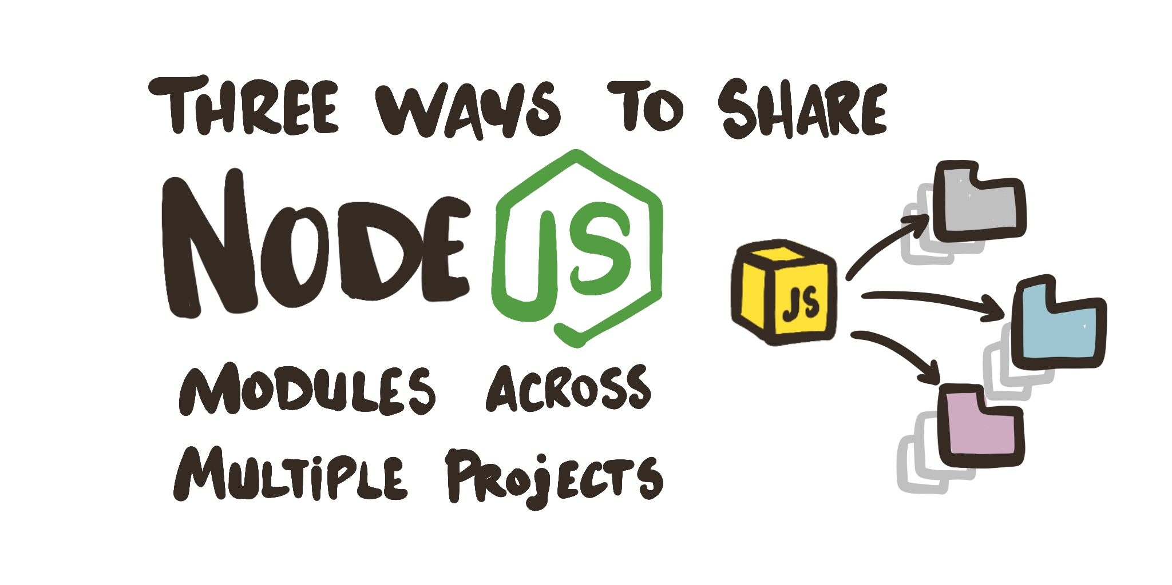
Node JS
There are three types of modules in Node.js
Importing from local module:
Importing from core modules:
Importing from third party modules:
Image Source: https://reverentgeek.com/content/images/3-ways-to-share-nodejs-modules-across-multiple-projects/3-ways-to-share-nodejs-modules-across-multiple-projects.jpg
Notes:
Left (White Color space):
Title - Parent Topic
Subtitle - Subtopic 1
Body Text - Description in bullets
Right (Grey Color Space):
Body Text - Relevant image (with source)/code snippet
Put reference links in Speaker Notes
Reference:
https://www.tutorialspoint.com/internet_technologies/internet_overview.htm/

Slide 17
Node JS
There are three types of modules in Node.js
Importing from local module: These modules are created by the user and can be imported as:
const var = require('./filename.js'); // OR const var = require('./path/filename.js');
Image Source: https://reverentgeek.com/content/images/3-ways-to-share-nodejs-modules-across-multiple-projects/3-ways-to-share-nodejs-modules-across-multiple-projects.jpg
Notes:
Left (White Color space):
Title - Parent Topic
Subtitle - Subtopic 1
Body Text - Description in bullets
Right (Grey Color Space):
Body Text - Relevant image (with source)/code snippet
Put reference links in Speaker Notes
Reference:
https://www.tutorialspoint.com/internet_technologies/internet_overview.htm/

Slide 18
Node JS
There are three types of modules in Node.js
Importing from core modules: These modules are inbuilt in Node.js and can be imported as:
const var = require('fs');
Image Source: https://reverentgeek.com/content/images/3-ways-to-share-nodejs-modules-across-multiple-projects/3-ways-to-share-nodejs-modules-across-multiple-projects.jpg
Notes:
Left (White Color space):
Title - Parent Topic
Subtitle - Subtopic 1
Body Text - Description in bullets
Right (Grey Color Space):
Body Text - Relevant image (with source)/code snippet
Put reference links in Speaker Notes
Reference:
https://www.tutorialspoint.com/internet_technologies/internet_overview.htm/

Slide 19
Node JS
There are three types of modules in Node.js
Importing from third party modules: These modules are installed using a package manager such as npm. Examples of third party modules are express, mongoose, nodemon, etc. These are imported as:
const express = require('express');
Image Source: https://reverentgeek.com/content/images/3-ways-to-share-nodejs-modules-across-multiple-projects/3-ways-to-share-nodejs-modules-across-multiple-projects.jpg
Notes:
Left (White Color space):
Title - Parent Topic
Subtitle - Subtopic 1
Body Text - Description in bullets
Right (Grey Color Space):
Body Text - Relevant image (with source)/code snippet
Put reference links in Speaker Notes
Reference:
https://www.tutorialspoint.com/internet_technologies/internet_overview.htm/

Slide 20
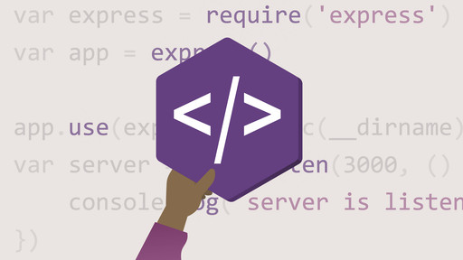
Node JS
Introduction package.json file
The package.json file is the heart of Node.js system. It is the manifest file of any Node.js project and contains the metadata of the project. The package.json file is the essential part to understand, learn and work with the Node.js. It is the first step to learn about development in Node.js.
Image Source: https://media-exp1.licdn.com/dms/image/C4E0DAQEkv_Z0B0NsDQ/learning-public-crop_288_512/0/1568669708190?e=2147483647&v=beta&t=HBztHgW9LhTcwsskwRwnevmN3WS0Q-FQFXTPspKe8Wg
Notes:
Left (White Color space):
Title - Parent Topic
Subtitle - Subtopic 1
Body Text - Description in bullets
Right (Grey Color Space):
Body Text - Relevant image (with source)/code snippet
Put reference links in Speaker Notes
Reference:
https://www.tutorialspoint.com/internet_technologies/internet_overview.htm/

Slide 21
Node JS
What does package.json file consist of?
The metadata information in package.json file can be categorized into below categories:
1. Identifying metadata properties: It basically consist of the properties to identify the module/project such as the name of the project, current version of the module, license, author of the project, description about the project etc.
Image Source: https://media-exp1.licdn.com/dms/image/C4E0DAQEkv_Z0B0NsDQ/learning-public-crop_288_512/0/1568669708190?e=2147483647&v=beta&t=HBztHgW9LhTcwsskwRwnevmN3WS0Q-FQFXTPspKe8Wg
Notes:
Left (White Color space):
Title - Parent Topic
Subtitle - Subtopic 1
Body Text - Description in bullets
Right (Grey Color Space):
Body Text - Relevant image (with source)/code snippet
Put reference links in Speaker Notes
Reference:
https://www.tutorialspoint.com/internet_technologies/internet_overview.htm/

Slide 22
Node JS
What does package.json file consist of?
2. Functional metadata properties: As the name suggests, it consists of the functional values/properties of the project/module such as the entry/starting point of the module, dependencies in project, scripts being used, repository links of Node project etc.
Image Source: https://media-exp1.licdn.com/dms/image/C4E0DAQEkv_Z0B0NsDQ/learning-public-crop_288_512/0/1568669708190?e=2147483647&v=beta&t=HBztHgW9LhTcwsskwRwnevmN3WS0Q-FQFXTPspKe8Wg
Notes:
Left (White Color space):
Title - Parent Topic
Subtitle - Subtopic 1
Body Text - Description in bullets
Right (Grey Color Space):
Body Text - Relevant image (with source)/code snippet
Put reference links in Speaker Notes
Reference:
https://www.tutorialspoint.com/internet_technologies/internet_overview.htm/

Slide 23
Node JS
Creating a package.json file:
A package.json file can be created in two ways:
Using npm init
Writing directly to file
Image Source: https://media-exp1.licdn.com/dms/image/C4E0DAQEkv_Z0B0NsDQ/learning-public-crop_288_512/0/1568669708190?e=2147483647&v=beta&t=HBztHgW9LhTcwsskwRwnevmN3WS0Q-FQFXTPspKe8Wg
Notes:
Left (White Color space):
Title - Parent Topic
Subtitle - Subtopic 1
Body Text - Description in bullets
Right (Grey Color Space):
Body Text - Relevant image (with source)/code snippet
Put reference links in Speaker Notes
Reference:
https://www.tutorialspoint.com/internet_technologies/internet_overview.htm/

Slide 24
Node JS
Creating a package.json file:
Using npm init : Running this command, system expects user to fill the vital information required as discussed above. It provides users with default values which are editable by the user.
Syntax:
npm init
Image Source: https://media-exp1.licdn.com/dms/image/C4E0DAQEkv_Z0B0NsDQ/learning-public-crop_288_512/0/1568669708190?e=2147483647&v=beta&t=HBztHgW9LhTcwsskwRwnevmN3WS0Q-FQFXTPspKe8Wg
Notes:
Left (White Color space):
Title - Parent Topic
Subtitle - Subtopic 1
Body Text - Description in bullets
Right (Grey Color Space):
Body Text - Relevant image (with source)/code snippet
Put reference links in Speaker Notes
Reference:
https://www.tutorialspoint.com/internet_technologies/internet_overview.htm/

Slide 25
Node JS
{ "name": " ADIT IBM ",
"version": "1.0.0",
"description": ”ADIT IBM",
"main": "index.js",
"scripts": {
"test": "echo \"Error: no test specified\" && exit 1",
"start": "node start.js",
},
"engines": { "node": ">=7.6.0", "npm": ">=4.1.2" },
"author": " ADIT IBM ",
"license": "ISC",
"dependencies": {
"body-parser": "^1.17.1",
"express": "^4.15.2",
"express-validator": "^3.1.2",
"mongoose": "^4.8.7",
"nodemon": "^1.14.12", },
"devDependencies": {},
"repository": {
"type": "git",
"url": "https://github.com/gfg/gfg.git" //sample git repo url
},
"bugs": { "url": "https://github.com/gfg/gfg/issues" },
"homepage": "https://github.com/gfg/gfg#readme" }
Creating a package.json file:
Writing directly to file : One can directly write into file with all the required information and can include it in the Node project.
Example: A demo package.json file with the required information.
Ref : https://www.geeksforgeeks.org/node-js-package-json/
Image Source: https://media-exp1.licdn.com/dms/image/C4E0DAQEkv_Z0B0NsDQ/learning-public-crop_288_512/0/1568669708190?e=2147483647&v=beta&t=HBztHgW9LhTcwsskwRwnevmN3WS0Q-FQFXTPspKe8Wg
Notes:
Left (White Color space):
Title - Parent Topic
Subtitle - Subtopic 1
Body Text - Description in bullets
Right (Grey Color Space):
Body Text - Relevant image (with source)/code snippet
Put reference links in Speaker Notes
Reference:
https://www.tutorialspoint.com/internet_technologies/internet_overview.htm/

Slide 26
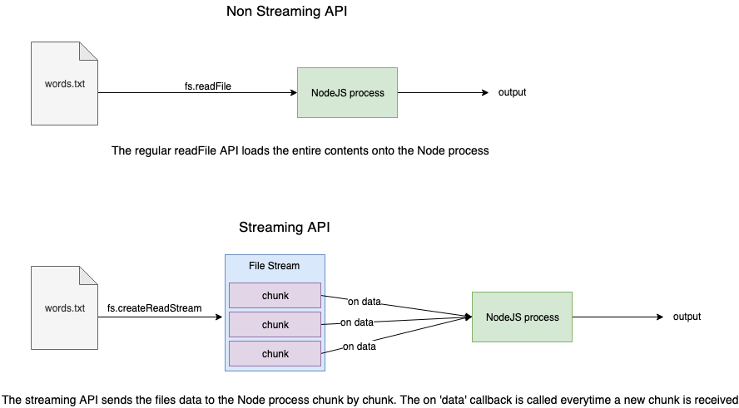
Node JS
File handling in Node.js
The most important functionalities provided by programming languages are Reading and Writing files from the computers. Node.js provides the functionality to read and write files from the computer. Reading and Writing the file in Node.js is done by using one of the coolest Node.js modules called fs module, it is one of the most well-known built-in Node.js modules out there
Image Source: https://www.sohamkamani.com/static/138a5d433cd2c4de04c25012fa45bae2/banner.png
Notes:
Left (White Color space):
Title - Parent Topic
Subtitle - Subtopic 1
Body Text - Description in bullets
Right (Grey Color Space):
Body Text - Relevant image (with source)/code snippet
Put reference links in Speaker Notes
Reference:
https://www.tutorialspoint.com/internet_technologies/internet_overview.htm/

Slide 27
Node JS
// Require the given module
var fs = require('fs');
// Use readFileSync() method
// Store the result (return value) of this
// method in a variable named readMe
// Keep the file in the same folder so
// donot need to specify the complete path
var readMe = fs.readFileSync('readMe.txt', 'utf-8');
// log the content of file stored in
// a variable to screen
console.log(readMe);
Synchronous method to read the file:
To read the file in synchronous mode we use a method in fs module which is readFileSync(). It takes two parameters first is the file name with complete path and the second parameter is the character encoding which is generally ‘utf-8’.
Notes:
Left (White Color space):
Title - Parent Topic
Subtitle - Subtopic 1
Body Text - Description in bullets
Right (Grey Color Space):
Body Text - Relevant image (with source)/code snippet
Put reference links in Speaker Notes
Reference:
https://www.tutorialspoint.com/internet_technologies/internet_overview.htm/

Slide 28
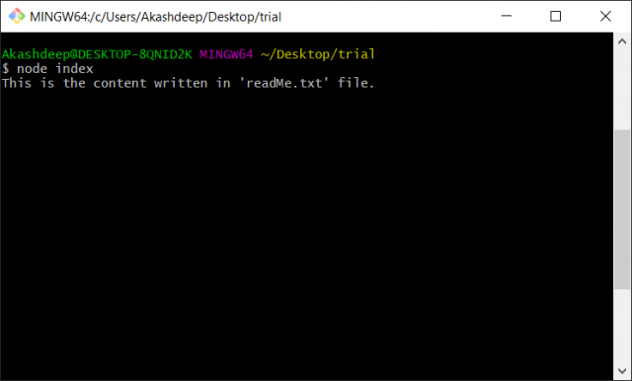
Node JS
Output :
Synchronous method to read the file:
o read the file in synchronous mode we use a method in fs module which is readFileSync(). It takes two parameters first is the file name with complete path and the second parameter is the character encoding which is generally ‘utf-8’.
Notes:
Left (White Color space):
Title - Parent Topic
Subtitle - Subtopic 1
Body Text - Description in bullets
Right (Grey Color Space):
Body Text - Relevant image (with source)/code snippet
Put reference links in Speaker Notes
Reference:
https://www.tutorialspoint.com/internet_technologies/internet_overview.htm/

Slide 29
Node JS
// Require the given module
var fs = require('fs');
// Use readFileSync() method
// Store the result (return value) of this
// method in a variable named readMe
var readMe = fs.readFileSync('readMe.txt', 'utf-8');
// Store the content and read from
// readMe.txt to a file WriteMe.txt
fs.writeFileSync('writeMe.txt', readMe);
Synchronous method to writing into a file:
To write the file in a synchronous mode we use a method in fs module which is writeFileSync(). It takes two parameters first is the file name with the complete path in which content is to be written and the second parameter is the data to be written in the file.
Notes:
Left (White Color space):
Title - Parent Topic
Subtitle - Subtopic 1
Body Text - Description in bullets
Right (Grey Color Space):
Body Text - Relevant image (with source)/code snippet
Put reference links in Speaker Notes
Reference:
https://www.tutorialspoint.com/internet_technologies/internet_overview.htm/

Slide 30
Node JS
Output :
Synchronous method to writing into a file:
To write the file in a synchronous mode we use a method in fs module which is writeFileSync(). It takes two parameters first is the file name with the complete path in which content is to be written and the second parameter is the data to be written in the file.
Notes:
Left (White Color space):
Title - Parent Topic
Subtitle - Subtopic 1
Body Text - Description in bullets
Right (Grey Color Space):
Body Text - Relevant image (with source)/code snippet
Put reference links in Speaker Notes
Reference:
https://www.tutorialspoint.com/internet_technologies/internet_overview.htm/

Slide 31
Node JS
// Require the given module
var fs = require('fs');
// Use readFile() method
fs.readFile('readMe.txt', 'utf-8', function(err, data) {
// Write the data read from readeMe.txt
// to a file writeMe.txt
if( !err )
fs.writeFile('writeMe.txt', data, (err)=>{
if( err ) {
throw err;
}
});
else
throw err;
});
Asynchronous method to read and write from/into a file:
to read/write the file in an asynchronous mode in fs module we use readFile() and writeFile() methods.
Notes:
Left (White Color space):
Title - Parent Topic
Subtitle - Subtopic 1
Body Text - Description in bullets
Right (Grey Color Space):
Body Text - Relevant image (with source)/code snippet
Put reference links in Speaker Notes
Reference:
https://www.tutorialspoint.com/internet_technologies/internet_overview.htm/

Slide 32
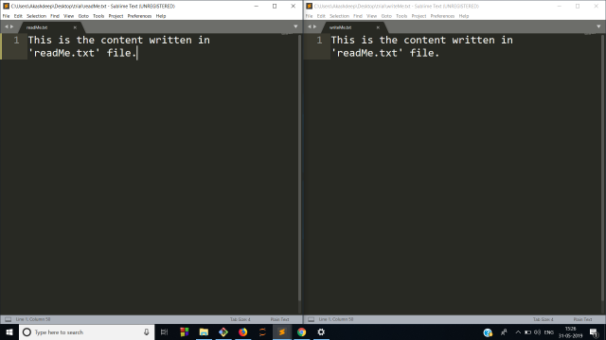
Node JS
Asynchronous method to read and write from/into a file:
Output
Notes:
Left (White Color space):
Title - Parent Topic
Subtitle - Subtopic 1
Body Text - Description in bullets
Right (Grey Color Space):
Body Text - Relevant image (with source)/code snippet
Put reference links in Speaker Notes
Reference:
https://www.tutorialspoint.com/internet_technologies/internet_overview.htm/

Slide 33
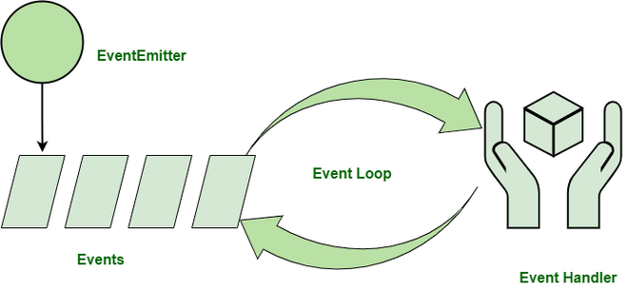
Node JS
Explain Event-Driven Programming in Node.js
Node.js makes extensive use of events which is one of the reasons behind its speed when compared to other similar technologies. Once we start a Node.js server, it initializes the variables and functions and then listens for the occurrence of an event.
Image Source: https://media.geeksforgeeks.org/wp-content/uploads/20211017211104/EDP1drawio-660x305.png
Notes:
Left (White Color space):
Title - Parent Topic
Subtitle - Subtopic 1
Body Text - Description in bullets
Right (Grey Color Space):
Body Text - Relevant image (with source)/code snippet
Put reference links in Speaker Notes
Reference:
https://www.tutorialspoint.com/internet_technologies/internet_overview.htm/

Slide 34
Node JS
Explain Event-Driven Programming in Node.js
Event-driven programming is used to synchronize the occurrence of multiple events and to make the program as simple as possible. The basic components of an Event-Driven Program are:
A callback function ( called an event handler) is called when an event is triggered.
An event loop that listens for event triggers and calls the corresponding event handler for that event.
Image Source: https://media.geeksforgeeks.org/wp-content/uploads/20211017211104/EDP1drawio-660x305.png
Notes:
Left (White Color space):
Title - Parent Topic
Subtitle - Subtopic 1
Body Text - Description in bullets
Right (Grey Color Space):
Body Text - Relevant image (with source)/code snippet
Put reference links in Speaker Notes
Reference:
https://www.tutorialspoint.com/internet_technologies/internet_overview.htm/

Slide 35
Node JS
Explain Event-Driven Programming in Node.js
Event-Driven Programming Principles:
A suite of functions for handling the events. These can be either blocking or non-blocking, depending on the implementation.
Binding registered functions to events.
When a registered event is received, an event loop polls for new events and calls the matching event handler(s).
Image Source: https://media.geeksforgeeks.org/wp-content/uploads/20211017211104/EDP1drawio-660x305.png
Notes:
Left (White Color space):
Title - Parent Topic
Subtitle - Subtopic 1
Body Text - Description in bullets
Right (Grey Color Space):
Body Text - Relevant image (with source)/code snippet
Put reference links in Speaker Notes
Reference:
https://www.tutorialspoint.com/internet_technologies/internet_overview.htm/

Slide 36
Node JS
Explain Event-Driven Programming in Node.js
Advantages of Event-Driven Programming:
Flexibility: It is easier to alter sections of code as and when required.
Suitability for graphical interfaces: It allows the user to select tools (like radio buttons etc.) directly from the toolbar
Programming simplicity: It supports predictive coding, which improves the programmer’s coding experience.
Image Source: https://media.geeksforgeeks.org/wp-content/uploads/20211017211104/EDP1drawio-660x305.png
Notes:
Left (White Color space):
Title - Parent Topic
Subtitle - Subtopic 1
Body Text - Description in bullets
Right (Grey Color Space):
Body Text - Relevant image (with source)/code snippet
Put reference links in Speaker Notes
Reference:
https://www.tutorialspoint.com/internet_technologies/internet_overview.htm/

Slide 37
Node JS
Explain Event-Driven Programming in Node.js
Advantages of Event-Driven Programming:
Easy to find natural dividing lines: Natural dividing lines for unit testing infrastructure are easy to come by.
A good way to model systems: Useful method for modeling systems that must be asynchronous and reactive.
Image Source: https://media.geeksforgeeks.org/wp-content/uploads/20211017211104/EDP1drawio-660x305.png
Notes:
Left (White Color space):
Title - Parent Topic
Subtitle - Subtopic 1
Body Text - Description in bullets
Right (Grey Color Space):
Body Text - Relevant image (with source)/code snippet
Put reference links in Speaker Notes
Reference:
https://www.tutorialspoint.com/internet_technologies/internet_overview.htm/

Slide 38
Node JS
Explain Event-Driven Programming in Node.js
Advantages of Event-Driven Programming:
Allows for more interactive programs: It enables more interactive programming. Event-driven programming is used in almost all recent GUI apps.
Using hardware interrupts: It can be accomplished via hardware interrupts, lowering the computer’s power consumption.
Image Source: https://media.geeksforgeeks.org/wp-content/uploads/20211017211104/EDP1drawio-660x305.png
Notes:
Left (White Color space):
Title - Parent Topic
Subtitle - Subtopic 1
Body Text - Description in bullets
Right (Grey Color Space):
Body Text - Relevant image (with source)/code snippet
Put reference links in Speaker Notes
Reference:
https://www.tutorialspoint.com/internet_technologies/internet_overview.htm/

Slide 39
Node JS
Explain Event-Driven Programming in Node.js
Advantages of Event-Driven Programming:
Allows sensors and other hardware: It makes it simple for sensors and other hardware to communicate with software.
Image Source: https://media.geeksforgeeks.org/wp-content/uploads/20211017211104/EDP1drawio-660x305.png
Notes:
Left (White Color space):
Title - Parent Topic
Subtitle - Subtopic 1
Body Text - Description in bullets
Right (Grey Color Space):
Body Text - Relevant image (with source)/code snippet
Put reference links in Speaker Notes
Reference:
https://www.tutorialspoint.com/internet_technologies/internet_overview.htm/

Slide 40
Node JS
Explain Event-Driven Programming in Node.js
Disadvantages of Event-Driven Programming:
Complex: Simple programs become unnecessarily complex.
Less logical and obvious: The flow of the program is usually less logical and more obvious
Image Source: https://media.geeksforgeeks.org/wp-content/uploads/20211017211104/EDP1drawio-660x305.png
Notes:
Left (White Color space):
Title - Parent Topic
Subtitle - Subtopic 1
Body Text - Description in bullets
Right (Grey Color Space):
Body Text - Relevant image (with source)/code snippet
Put reference links in Speaker Notes
Reference:
https://www.tutorialspoint.com/internet_technologies/internet_overview.htm/

Slide 41
Node JS
Explain Event-Driven Programming in Node.js
Disadvantages of Event-Driven Programming:
Difficult to find error: Debugging an event-driven program is difficult
Confusing: Too many forms in a program might be confusing and/or frustrating for the programmer.
Image Source: https://media.geeksforgeeks.org/wp-content/uploads/20211017211104/EDP1drawio-660x305.png
Notes:
Left (White Color space):
Title - Parent Topic
Subtitle - Subtopic 1
Body Text - Description in bullets
Right (Grey Color Space):
Body Text - Relevant image (with source)/code snippet
Put reference links in Speaker Notes
Reference:
https://www.tutorialspoint.com/internet_technologies/internet_overview.htm/

Slide 42
Node JS
Explain Event-Driven Programming in Node.js
Disadvantages of Event-Driven Programming:
Tight coupling: The event schema will be tightly coupled with the consumers of the schema.
Blocking: Complex blocking of operations.
Image Source: https://media.geeksforgeeks.org/wp-content/uploads/20211017211104/EDP1drawio-660x305.png
Notes:
Left (White Color space):
Title - Parent Topic
Subtitle - Subtopic 1
Body Text - Description in bullets
Right (Grey Color Space):
Body Text - Relevant image (with source)/code snippet
Put reference links in Speaker Notes
Reference:
https://www.tutorialspoint.com/internet_technologies/internet_overview.htm/

Slide 43
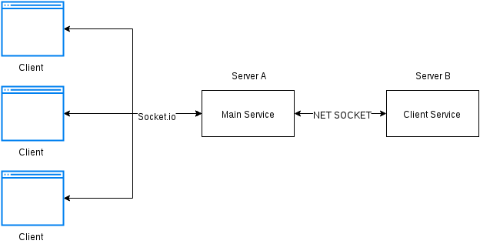
Node JS
What is a Web Socket?
Web Socket is a protocol that provides full-duplex(multiway) communication i.e allows communication in both directions simultaneously. It is a modern web technology in which there is a continuous connection between the user’s browser(client) and the server. In this type of communication, between the web server and the web browser, both of them can send messages to each other at any point in time.
Image Source: https://i.stack.imgur.com/Ydwdx.png
Notes:
Left (White Color space):
Title - Parent Topic
Subtitle - Subtopic 1
Body Text - Description in bullets
Right (Grey Color Space):
Body Text - Relevant image (with source)/code snippet
Put reference links in Speaker Notes
Reference:
https://www.tutorialspoint.com/internet_technologies/internet_overview.htm/

Slide 44
Node JS
What is a Web Socket?
We can simply install it by running the below command in cmd and then add this dependency to your server-side javascript file also install an express module which is basically required for server-side application
npm install socket.io --save
npm install express --save
Image Source: https://i.stack.imgur.com/Ydwdx.png
Notes:
Left (White Color space):
Title - Parent Topic
Subtitle - Subtopic 1
Body Text - Description in bullets
Right (Grey Color Space):
Body Text - Relevant image (with source)/code snippet
Put reference links in Speaker Notes
Reference:
https://www.tutorialspoint.com/internet_technologies/internet_overview.htm/

Slide 45
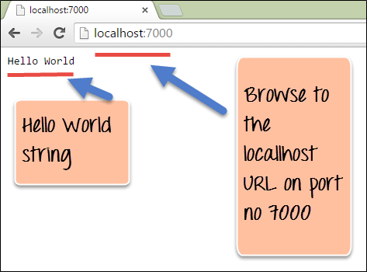
Node JS
How to Build a Simple Web Server with Node.js ?
Introduction: Node.js is an open-source and cross-platform runtime environment for executing JavaScript code outside a browser. You need to remember that NodeJS is not a framework, and it’s not a programming language. Node.js is mostly used in server-side programming. In this article, we will discuss how to make a web server using node.js.
Image Source: https://www.guru99.com/images/NodeJS/010716_0600_NodejsHttpT2.png
Notes:
Left (White Color space):
Title - Parent Topic
Subtitle - Subtopic 1
Body Text - Description in bullets
Right (Grey Color Space):
Body Text - Relevant image (with source)/code snippet
Put reference links in Speaker Notes
Reference:
https://www.tutorialspoint.com/internet_technologies/internet_overview.htm/

Slide 46
Node JS
How to Build a Simple Web Server with Node.js ?
Creating Web Servers Using NodeJS: There are mainly two ways as follows.
Using http inbuilt module
Using express third party module
Image Source: https://www.guru99.com/images/NodeJS/010716_0600_NodejsHttpT2.png
Notes:
Left (White Color space):
Title - Parent Topic
Subtitle - Subtopic 1
Body Text - Description in bullets
Right (Grey Color Space):
Body Text - Relevant image (with source)/code snippet
Put reference links in Speaker Notes
Reference:
https://www.tutorialspoint.com/internet_technologies/internet_overview.htm/

Slide 47
Node JS
How to Build a Simple Web Server with Node.js ?
Using http module: HTTP and HTTPS, these two inbuilt modules are used to create a simple server. The HTTPS module provides the feature of the encryption of communication with the help of the secure layer feature of this module. Whereas the HTTP module doesn’t provide the encryption of the data.
Image Source: https://www.guru99.com/images/NodeJS/010716_0600_NodejsHttpT2.png
Notes:
Left (White Color space):
Title - Parent Topic
Subtitle - Subtopic 1
Body Text - Description in bullets
Right (Grey Color Space):
Body Text - Relevant image (with source)/code snippet
Put reference links in Speaker Notes
Reference:
https://www.tutorialspoint.com/internet_technologies/internet_overview.htm/

Slide 48
Node JS
How to Build a Simple Web Server with Node.js ?
Using express module: The express.js is one of the most powerful frameworks of the node.js that works on the upper layer of the http module. The main advantage of using express.js server is filtering the incoming requests by clients.
Installing module: Install the required module using the following command.
npm install express
Image Source: https://www.guru99.com/images/NodeJS/010716_0600_NodejsHttpT2.png
Notes:
Left (White Color space):
Title - Parent Topic
Subtitle - Subtopic 1
Body Text - Description in bullets
Right (Grey Color Space):
Body Text - Relevant image (with source)/code snippet
Put reference links in Speaker Notes
Reference:
https://www.tutorialspoint.com/internet_technologies/internet_overview.htm/

